Slide 1
Ion Pumps - Introduction & Examples
11th grade
A short overview

Slide 2
Introduction
11th grade
The protein that transport ions across a biological membrane from a region of low concentration to higher concentration are called an ion pump.
The primary proteins that transport ions require energy.
Secondary transporters transports ions using potential energy created by the primary transporters
A short overview
Ion Pumps - Introduction & Examples

Slide 3
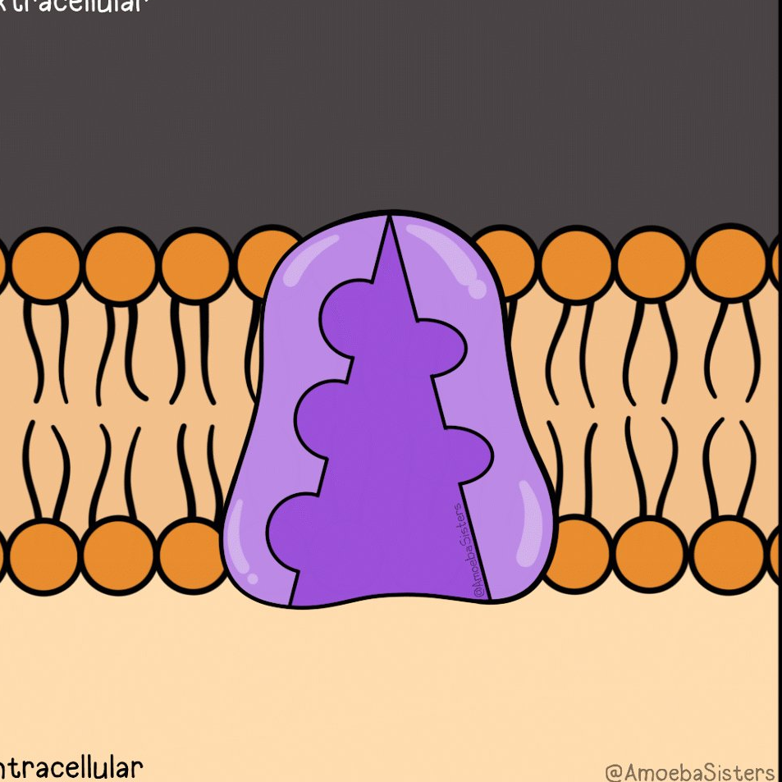
Sodium Potassium Pump
Concentration of Na+ ion in extracellular fluid is more than in the intracellular fluid and concentration of K+ ion in intracellular fluid is more than in extracellular fluid.

Slide 4
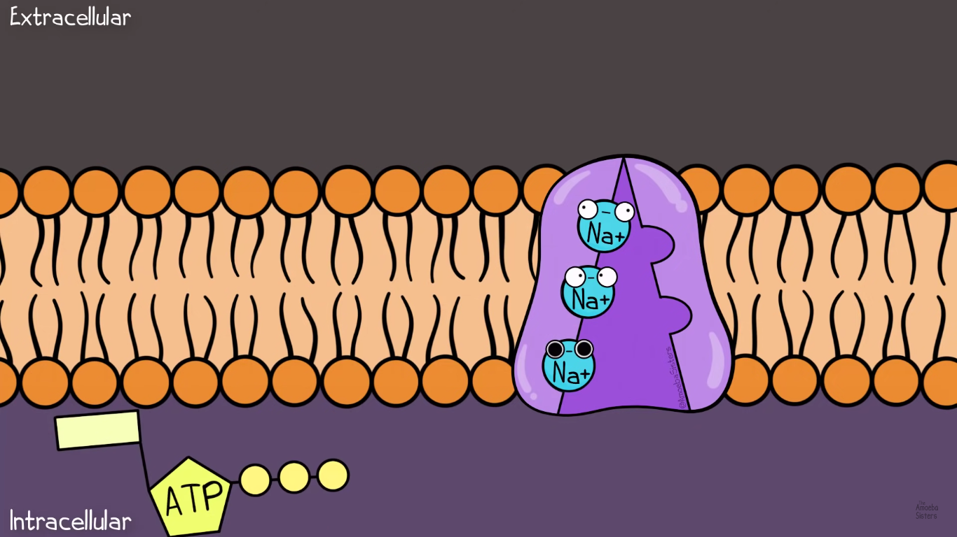
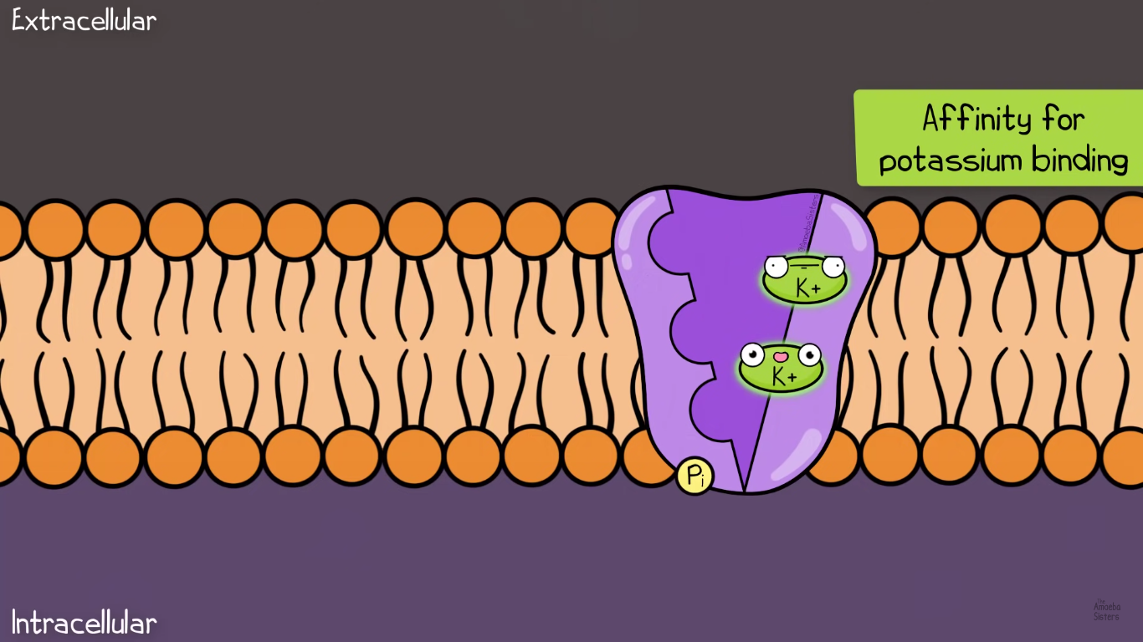
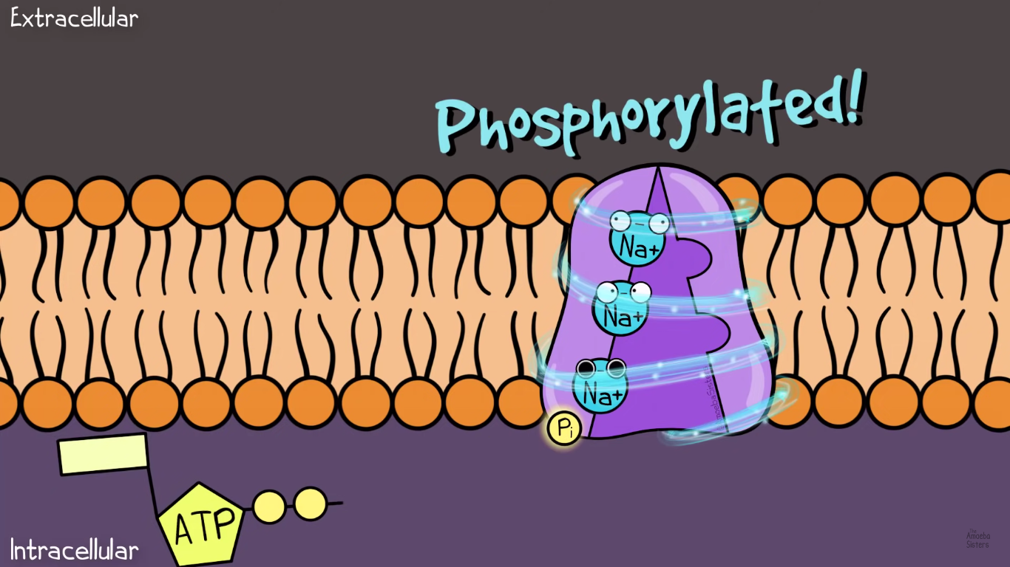
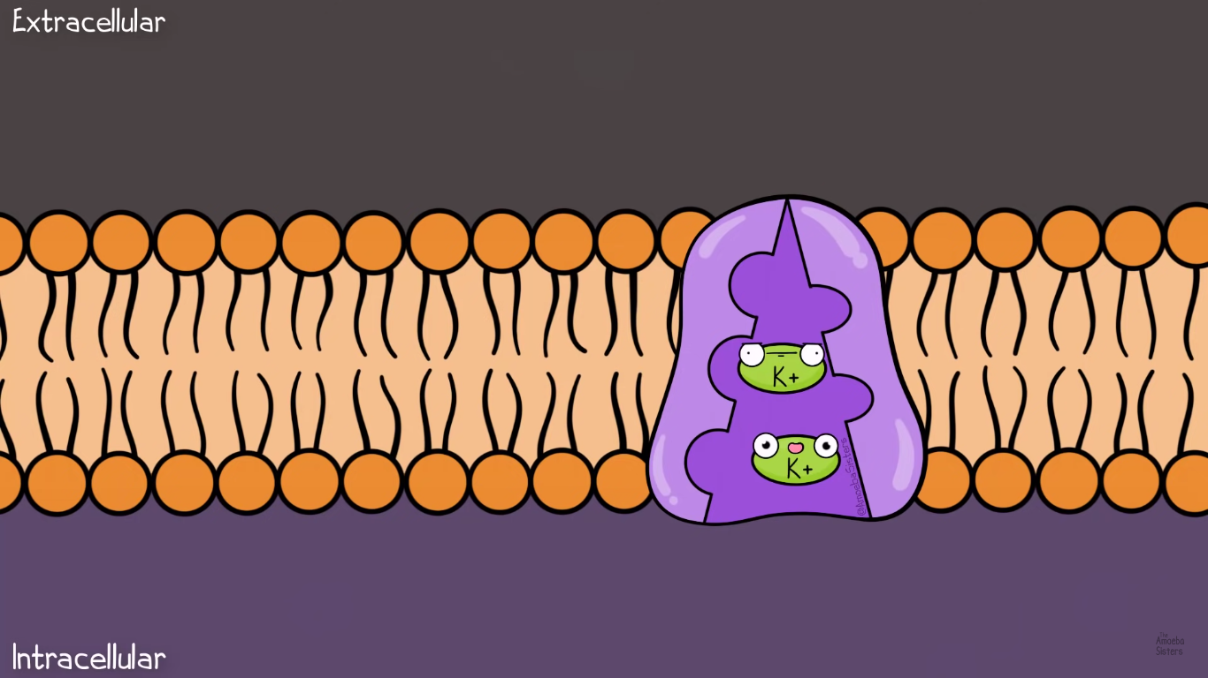
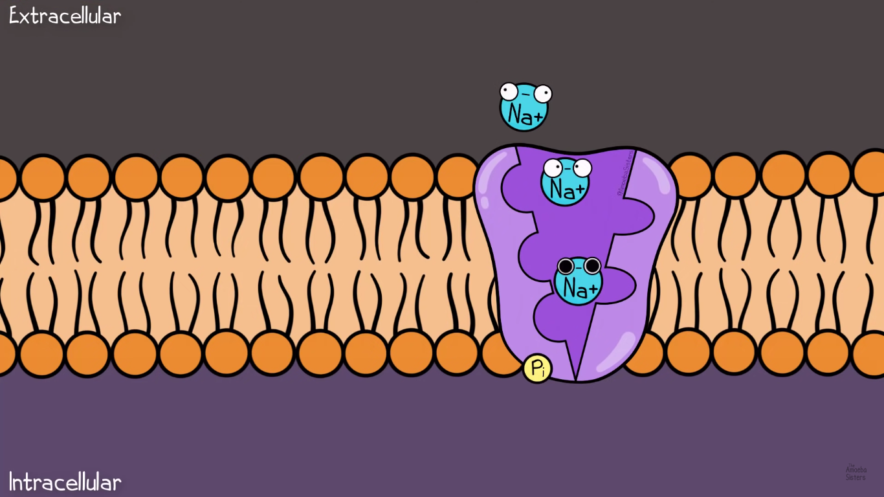
Initially open on the intracellular side with affinity for sodium binding

Slide 5
Initially open on the intracellular side with affinity for sodium binding
One phosphate from ATP transfers to the protein

Slide 6
Initially open on the intracellular side with affinity for sodium binding
A phosphate from ATP transfers to the protein
Change in shape occurs, leading to the pump being open to the outside

Slide 7
Change in shape occurs, leading to the pump being open to the outside
One phosphate from ATP transfers to the protein
Then Two Potassium ions bind to the protein

Slide 8
Then Two Potassium ions bind to the protein
Change in shape occurs, leading to the pump being open to the outside
K ions move to intracellular part and the cycle continues

Slide 9
K ions move to intracellular part and the cycle continues
Then Two Potassium ions bind to the protein

Slide 10
Initially open on the intracellular side with affinity for sodium binding

Slide 11
Conclusion from Sodium Potassium Pump
Source of energy
Energy is obtained by conversion of ATP in the ADP.
Result
In each pump three Na+ ion is released in the extracellular fluid and two K+ ion in to the intracellular fluid.
Significance
Nerve impulse transmission occurs.
High concentration of Na+ ion provides driving force for secondary transport of glucose, amino acids, other nutrients.

Slide 12
Sodium Glucose Pump
Glucose is necessary as it provides energy for various cell functions
Allows glucose to enter into cells.
Active in intestinal and kidney cells..
Driving force of sodium ion provides energy.
Every Na+ ion transport one molecule of glucose.
Glucose enters against the concentration gradient.
Example of secondary active transporter.

Slide 13
Thanks!
Do you have any questions?
023NEB729@sxc.edu.np

